Slide 1
Stuck? Get unstuck.
How to unlock your free, personal anytime, anywhere study help.
Your logo
Powered by:

Slide 2
What is it?
Anytime, anywhere study help and writing feedback online, from real people.
Studiosity is Australian-owned, with 1.6million students with access around the world.
So – do you usually study after dinner? On the weekends? Whenever you study, we’ve got you, and you’ve got this.
Because the best students know to ask for help. And everyone needs help sometimes.
Notes:
That’s right. Did you know that 1.6 million students have access to Studiosity? With the famous ‘help not answers’ policy, teachers, parents, university professors, and governments have approved Studiosity as an ethical service.

Slide 3
Why should I use this?
How does an additional 15% on your assignment sound?
Because that’s the average difference between students who use Studiosity and those who don’t.
Even if two students start at the same level.
But most important is feeling better about your own study.

Slide 4
How does it work? In your personal Studiosity dashboard, simply choose:
Connect live
For when you need
help right now.
Writing feedback
Get same-day,
English-writing feedback.
Notes:
The rest is up to you.
Got a draft essay? You can connect live, for immediate feedback on something you’re stuck on. Or done as much as you can on your assignment today and ready to go to bed? Upload your whole draft and one of the Subject Specialists will have feedback ready the next day.
What about a maths question? Connect Live. Draw it out on an interactive whiteboard.
Chemistry? Physics? You’re covered.
You can even get feedback on a resume!

Slide 5
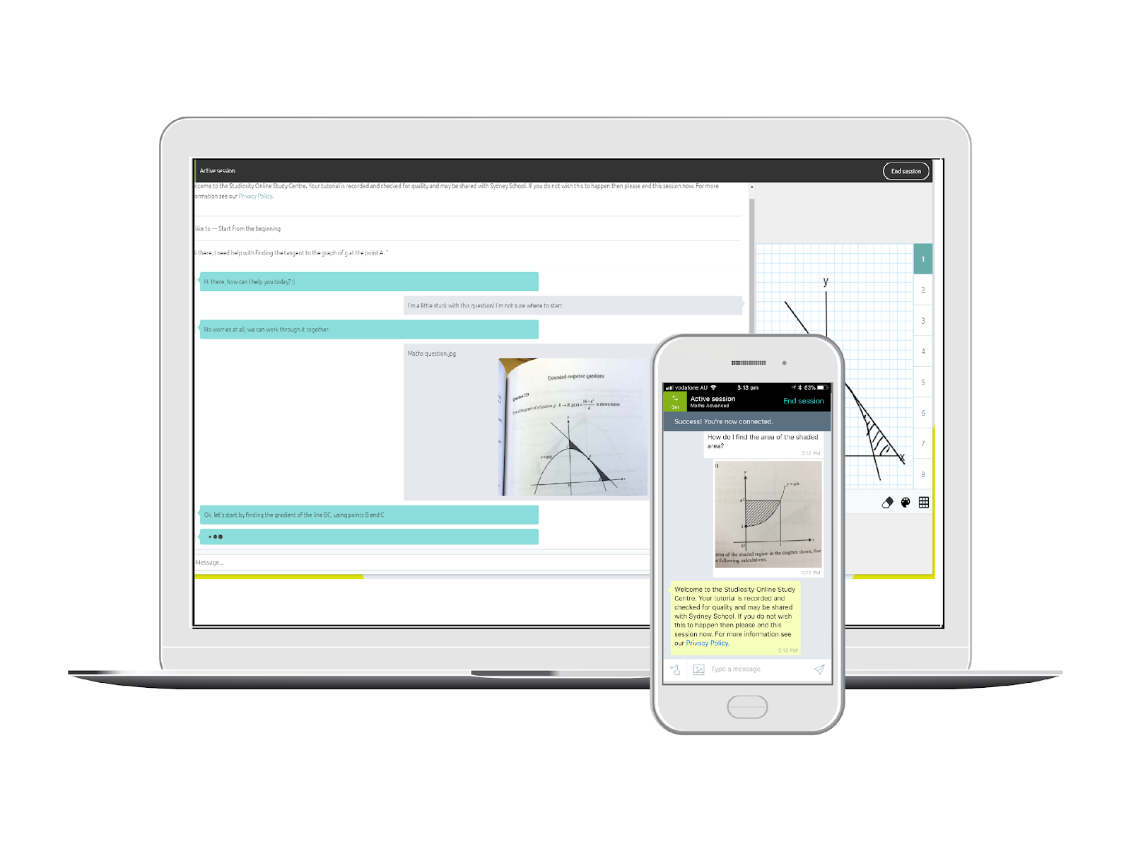
Tell me more about
Connect Live
Ask a question, connect to a real person anytime, 24/7, 365 days a year.
They’ll help with your exact problem that you’re stuck on.
Chat back and forth, draw on the whiteboard, share a file.
All core subject areas – Maths, Science, English, study skills, and more.
psst. There’s also
an app, of course.

Slide 6
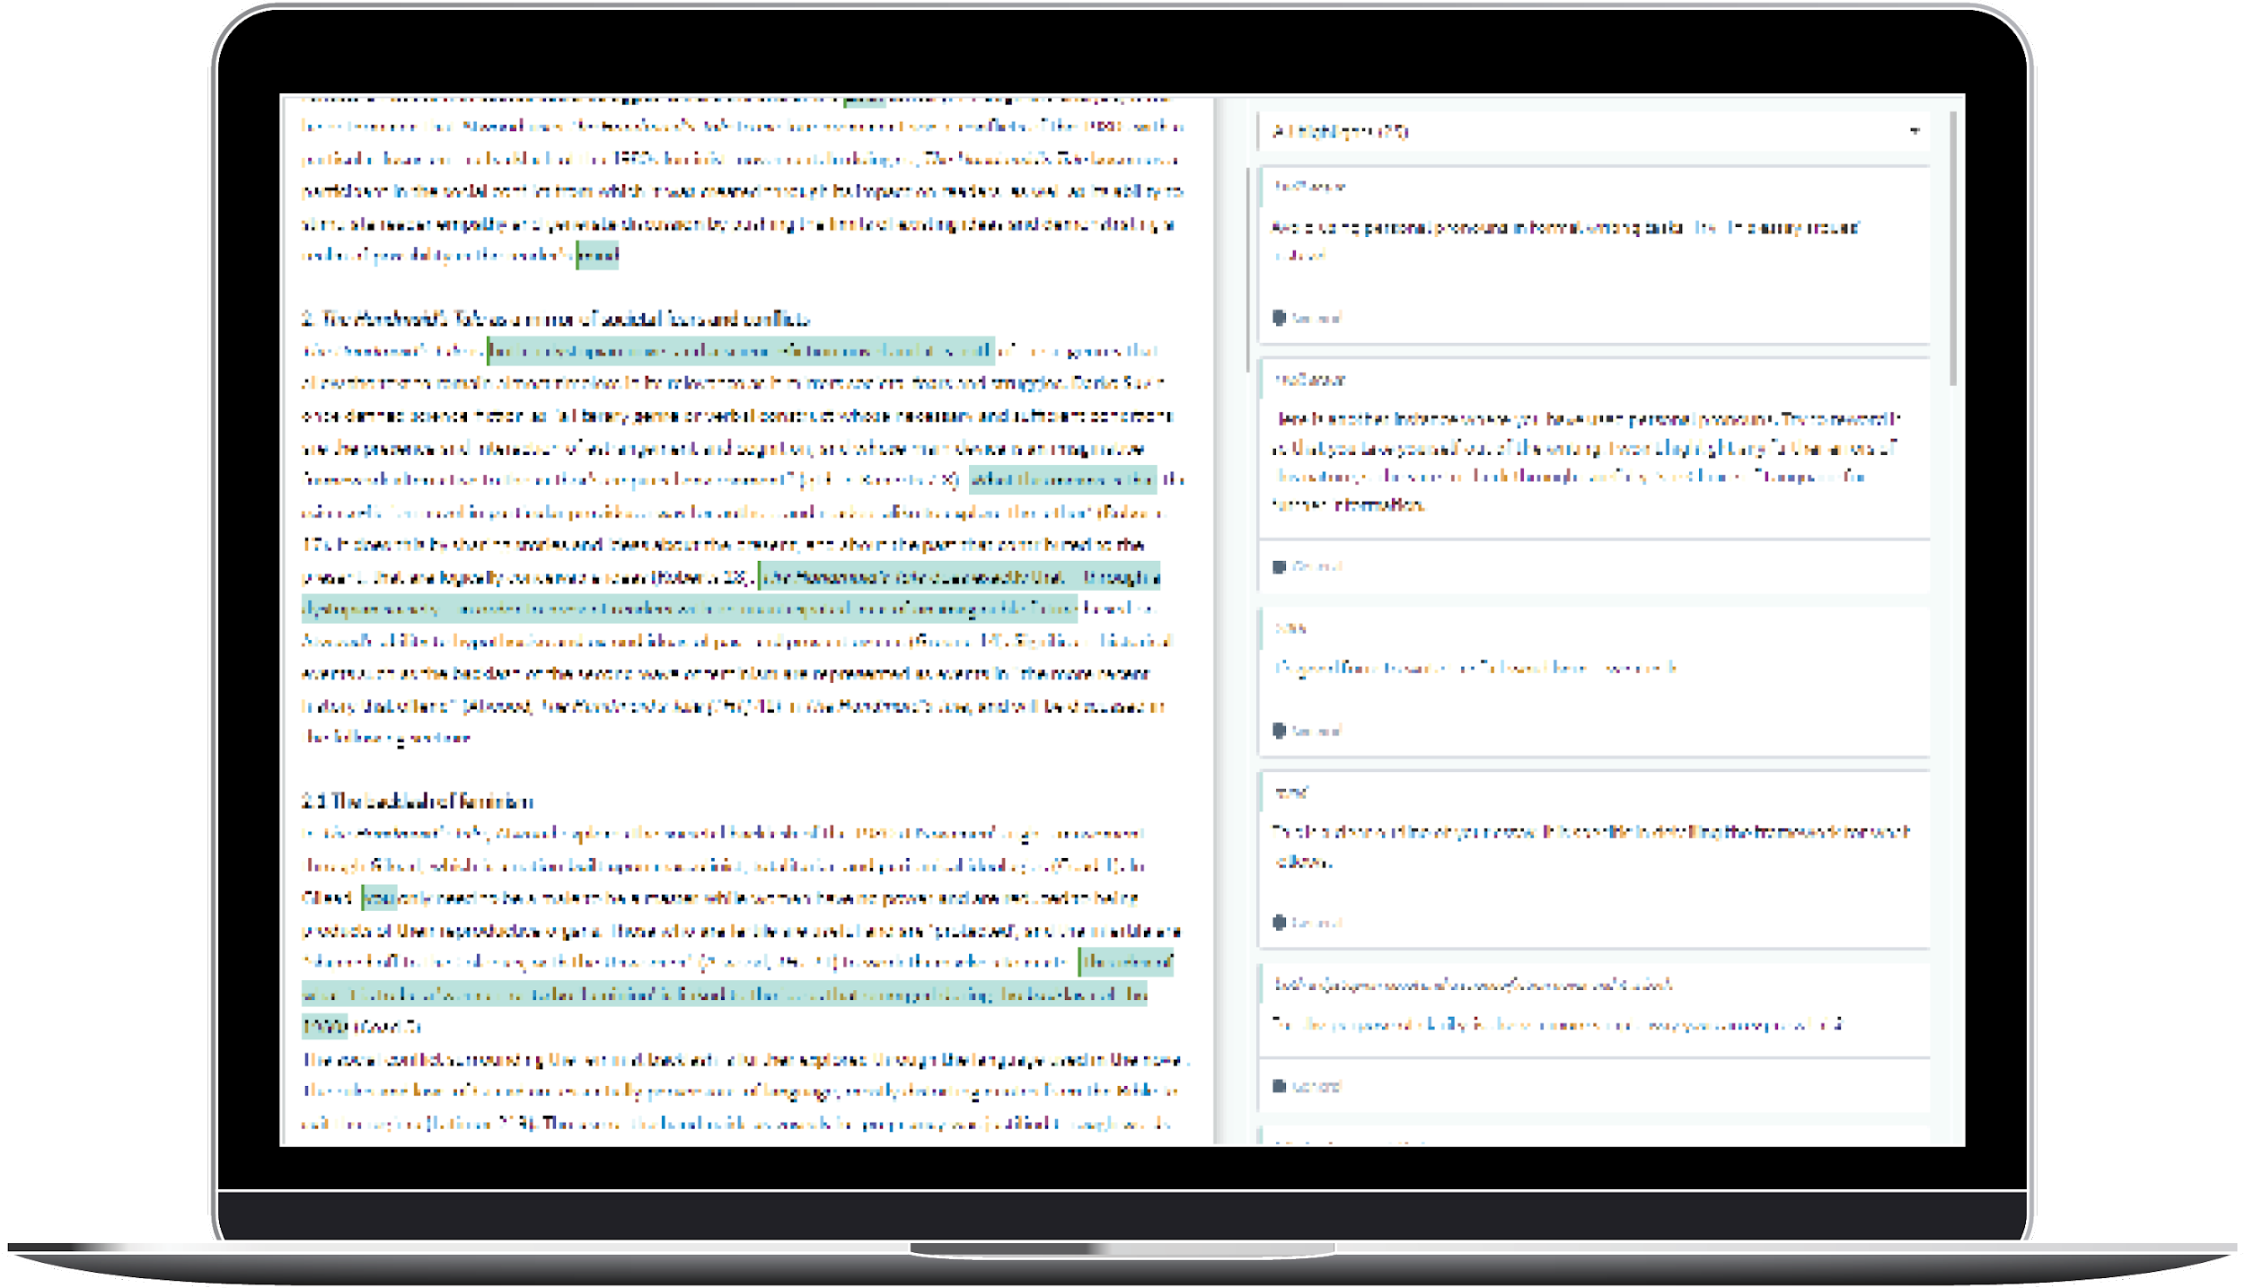
Tell me more about
Writing Feedback
Upload your draft essay or written assignment, and get it back in the same day with tips and notes on how to make it better
Any time of day, 365 days a year
Any subject, any assignment
Feedback on spelling, grammar, structure, language and more.

Slide 7
Amazing. I really need some answers...
Sorry.
Studiosity is ‘help not answers’. That’s why teachers, librarians, lecturers, parents, teachers trust it.
You will come to the answer on your own with some help, you will think about how to improve your own work. Which will make you feel more confident and better prepared for next time.

Slide 8
How do I get free access?
It’s easy, go to:
studiosity.com/access
+ your school email address or library card number.
That’s it.
‹#›
Notes:
Some amazing person is probably showing you this presentation, they can help you!

Slide 9
Then what?
Tonight:
1. Choose an essay, speech, or other assignment - it can be an old file of yours, or one you are working on now.
2. Upload to the ‘Writing Feedback’ option.
3. Get English-writing feedback in just a few hours from a real person. No answers here, but helpful feedback.
‹#›

Slide 10
And then?
Later this week, maybe Sunday afternoon:
1. Choose a maths or chemistry, biology, or physics question from your homework.
2. Use the “Connect Live” option.
3. Have a great chat with a real person, to get ‘help not answers’, to make you feel more confident about your study this term.
‹#›

Slide 11
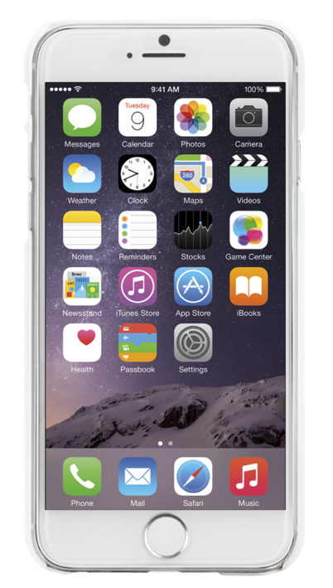
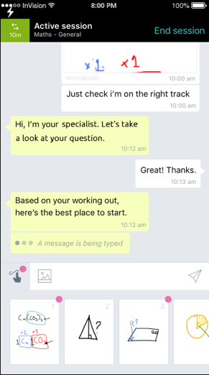
So there is an app?
When you open your account, you can access the mobile app for free.
Save a question for later
Snap & upload a photo of a problem
Get notifications and review your Writing Feedback
Use voice-to-text
Review past sessions
‹#›

Slide 12
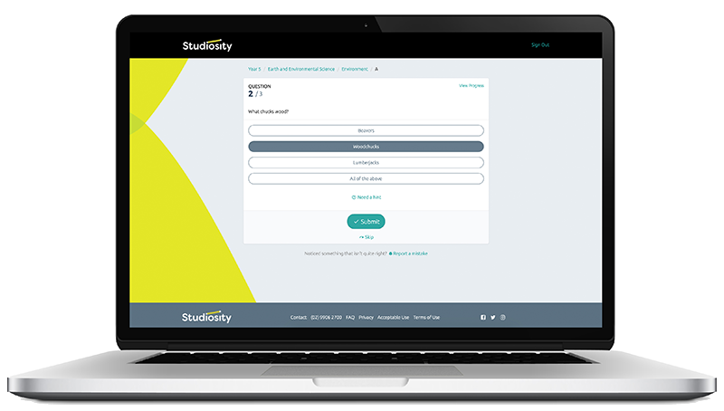
That’s great, but I’d like even more.
You can practice your skills with quizzes.
Your Studiosity dashboard includes access to over 750 practice quizzes.
These quizzes are available across English, Maths, Chemistry, Physics and Biology.

Slide 13
But I don’t want to ask a silly question.
There’s no such thing as a silly question in Studiosity. If you don’t know, if you’re getting frustrated, if you want to think ‘out loud’ – ask!
But you have to decide to reach out. You get to decide how this year will go.
Log into your Studiosity account, ask your question, upload your file. Feel better.
‹#›

Slide 14
Who are the people helping me?
Clever people in Australia, New Zealand, Canada, and the UK.
They are graduates of the world’s top 5% of universities. We are strict about who we bring onto our team.
They are Specialists in their field - if you ask a maths question, you’ll chat with someone who knows their maths. For writing feedback, you’ll get one of our Specialists who is a whiz with English writing.
Note: Not all our Specialists are working next to their dog (but some might be!)

Slide 15
In real life
“My best advice is to use Studiosity regularly. Studiosity is my secret weapon. They are what allowed me to achieve all my study goals. I really enjoyed using Studiosity because every Subject Specialist has an amazing approach. They explain the content in a way that you will easily understand.”
Mariam A
ATAR: 97.6
Mariam!
Btw, her story is here.

Slide 16
P.S. You’ve probably heard of Studiosity here:

Slide 17
All thanks to Australia’s leading community leaders, teachers, librarians, local government, and institutions.
Notes:
Studiosity is run in partnership with government, universities, schools only.
There is no public access, so remember to thank your teacher, librarian, lecturer. They’re doing this for you.

Slide 18
Now, unlock your Studiosity account:
studiosity.com/access
+ your school email address or library card number.
‹#›
Notes:
There is also a giant Support FAQ here: https://support.studiosity.com/ if you really have trouble getting into your account.

