Slide 1
Stuck? Get unstuck.
How to unlock your free, personal anytime, anywhere study help.
University logo
Powered by:

Slide 2
What is it?
Our Studiosity service is anytime, anywhere study help and writing feedback.
Around the world, 1.6 million students have access to Studiosity. It is only available within your university student login.
So – do you study after hours, after dinner? On the weekends? The university is with you, 24/7.
Because the best students know to ask for feedback and help.
Notes:
That’s right. Did you know that 1.6 million students have access to Studiosity? With the famous ‘help not answers’ policy, teachers, parents, university professors, and governments have approved Studiosity as an ethical service.

Slide 3
Why should I use this?
How does an additional 15% on your assignment sound?
Because that’s the average difference between students who use Studiosity and those who don’t.
Even if two students start at the same level.
But most important is feeling better about your own study. This has the greatest long-term impact on your success.

Slide 4
How does it work? In your personal Studiosity dashboard, simply choose:
Connect Live
For when you need
help right now.
Writing Feedback
Get same-day,
English-writing
feedback.
Student Connect
Any question; chat to a senior student at the University.
Available at selected universities.
Notes:
The rest is up to you.
Got a draft essay? You can connect live, for immediate feedback on something you’re stuck on. Or done as much as you can on your assignment today and ready to go to bed? Upload your whole draft and one of the Subject Specialists will have feedback ready the next day.
What about a maths question? Connect Live. Draw it out on an interactive whiteboard.
Chemistry? Physics? You’re covered.
You can even get feedback on a resume!

Slide 5
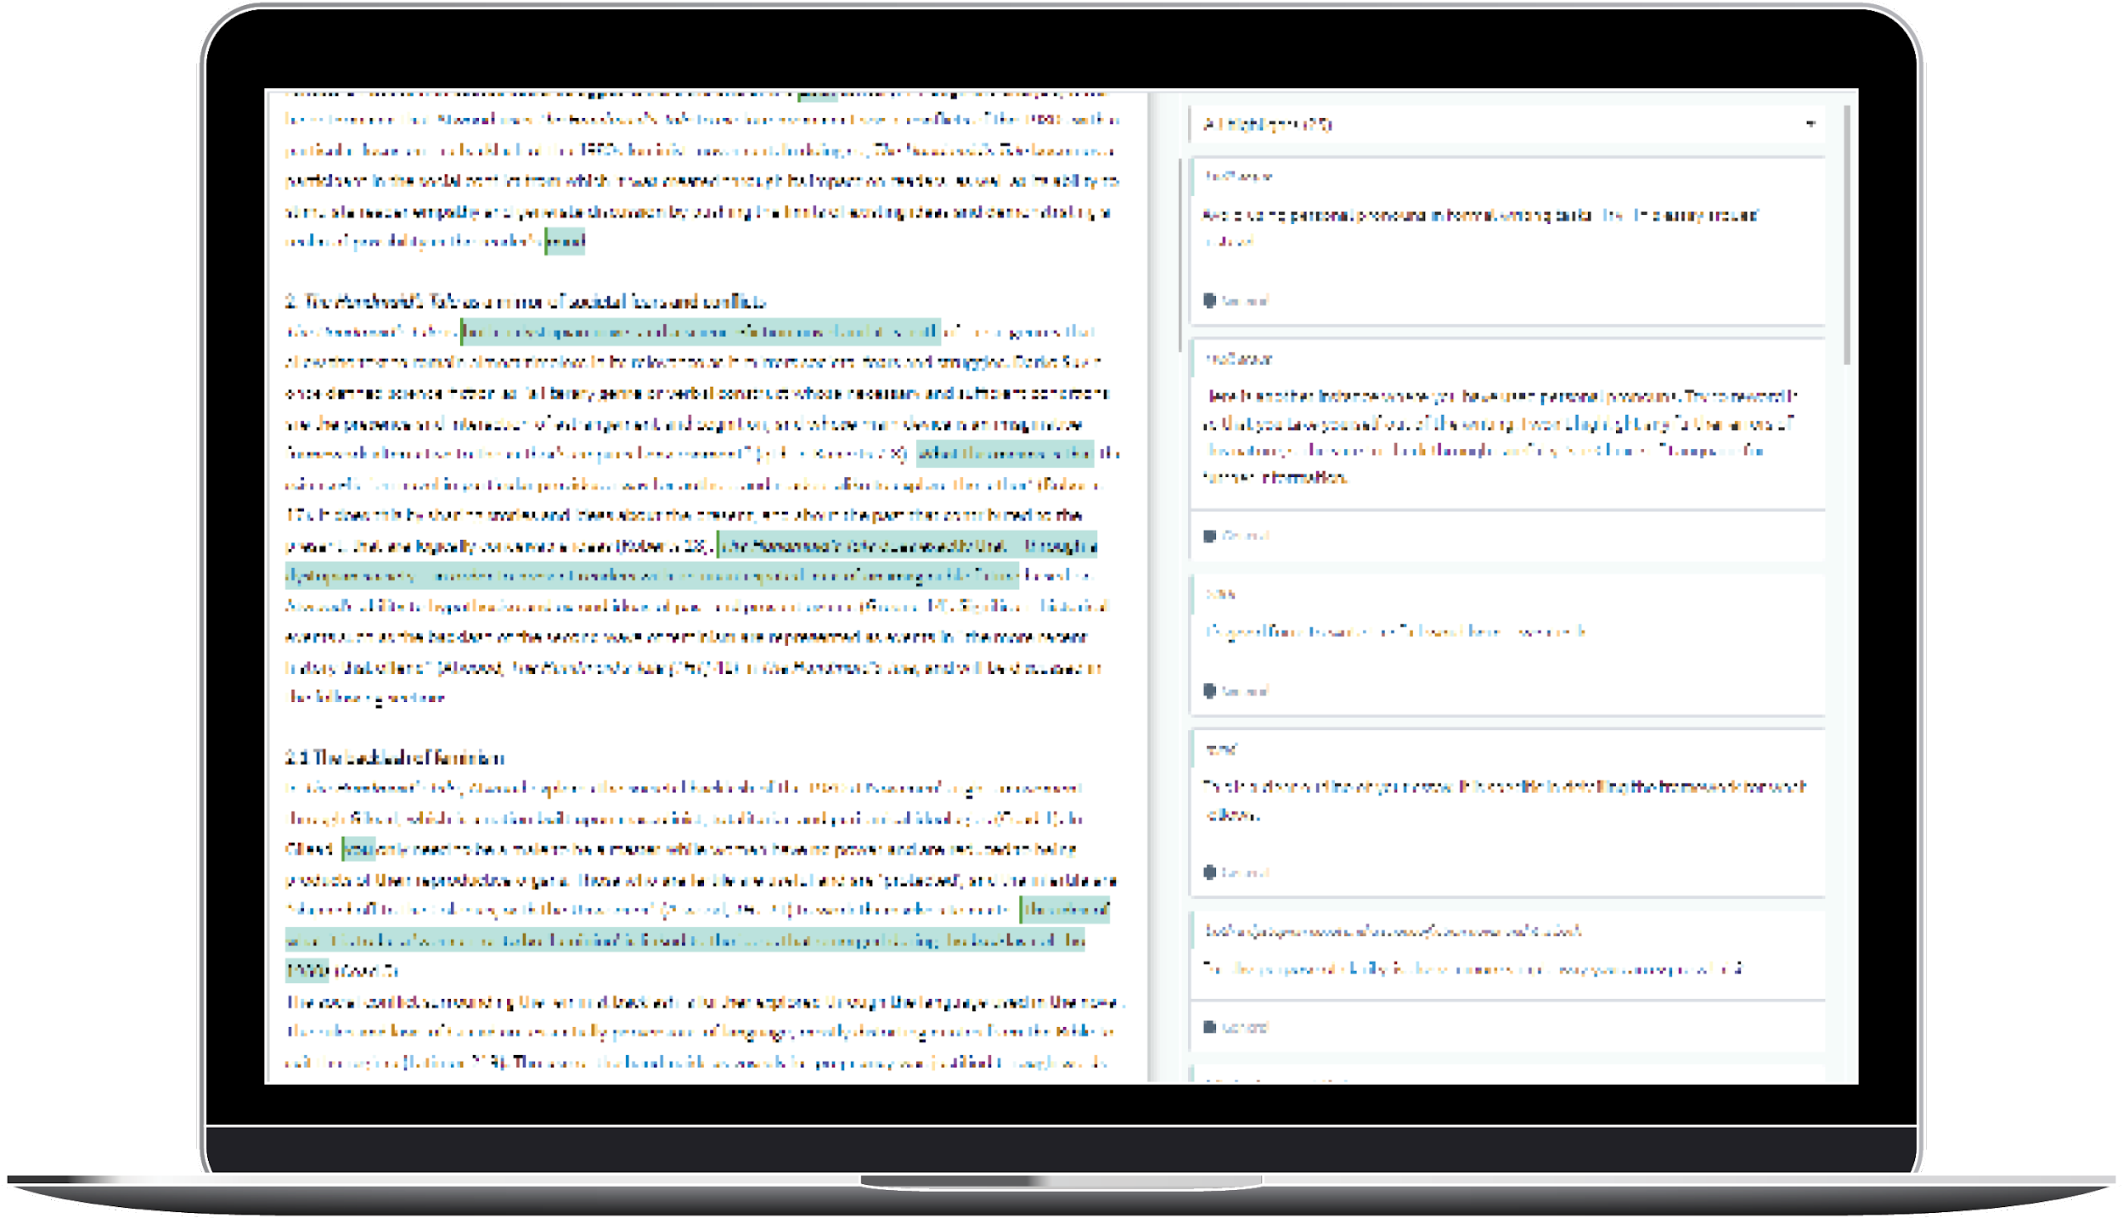
Tell me more about
Writing Feedback
Upload your draft essay or written assignment, and get it back in the same day with tips and notes on how to make it better
Any time of day, 365 days a year
Any subject, any assignment
Feedback on spelling, grammar, structure, language and more.

Slide 6
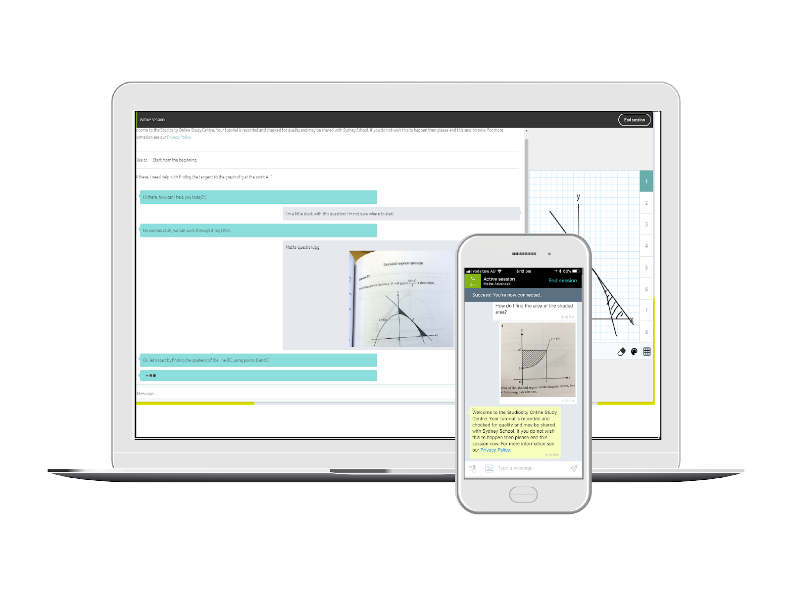
Tell me more about
Connect Live
Ask a question, connect to a real person anytime, 24/7, 365 days a year.
They’ll help with your exact problem that you’re stuck on.
Chat back and forth, draw on the whiteboard, share a file.
All core subject areas – Maths, Science, English, study skills, and more.
psst. There’s also
an app, of course.

Slide 7
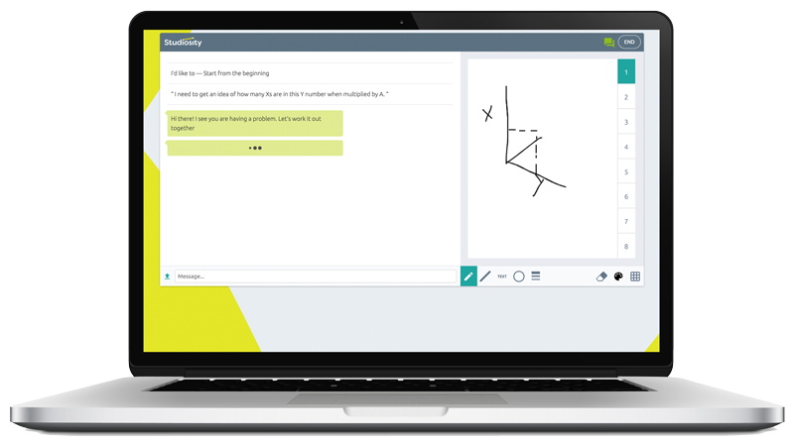
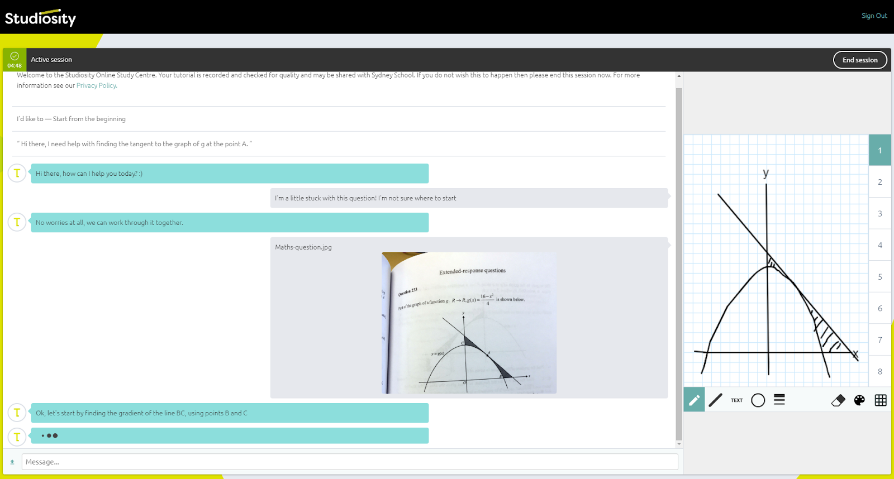
Tell me more about
Student Connect
Connect online to a more senior student at your university (who is available and wants to help!)
How can I research better? How can I get through readings faster? How can I take better notes? What did you do in first year to get high marks?
Chat about an assignment, university life, or anything else you need.

Slide 8
Amazing. I really need some answers...
Sorry.
Studiosity is ‘help not answers’. That’s why our university offers it to you.
You will come to the answer on your own with some help, you will think about how to improve your own work, which will make you feel more confident and more prepared for next time.

Slide 9
How do I get free access?
The Studiosity link is in your university student login.
That’s it.
‹#›
Notes:
Some amazing person is probably showing you this presentation, they can help you! Studiosity is run in partnership with the university only.
There is no public access, it is only available via your university student login.

Slide 10
Then what?
Tonight:
1. Choose an essay, speech, or other assignment - it can be an old file of yours, or one you are working on now.
2. Upload to the ‘Writing Feedback’ option.
3. Get English-writing feedback in just a few hours from a real person.
‹#›

Slide 11
And then?
Later this week:
1. Choose a maths or chemistry, biology, or physics question, or part of your written assignment that you are struggling with.
2. Use the “Connect Live” or “Student Connect” option.
3. Have a chat with a real person - a Subject Specialist or another student - to get ‘help not answers’ and to feel more confident with study this semester.
‹#›

Slide 12
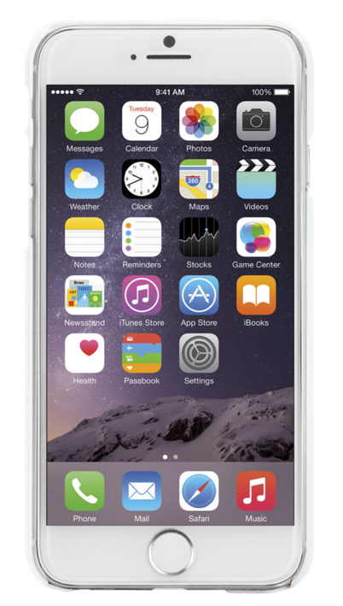
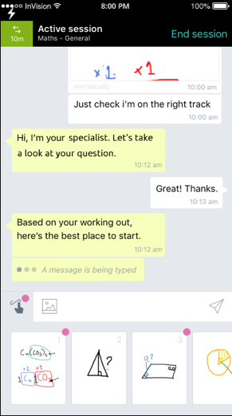
So there is an app?
When you open your account, you can access the mobile app for free.
Save a question for later
Snap & upload a photo of a problem
Get notifications and review your Writing Feedback
Use voice-to-text
Review past sessions
‹#›

Slide 13
But I don’t want to ask a silly question.
There’s no such thing as a silly question in Studiosity. If you don’t know, if you’re getting frustrated, if you want to think ‘out loud’ – ask!
But you have to decide to reach out. You get to decide how this year will go.
Log into your Studiosity account, ask your question, upload your file. Feel better.
‹#›

Slide 14
Who are the people helping me?
They are graduates of the world’s top 5% of universities, only based in Australia, New Zealand, Canada, and the UK.
They are Specialists in that subject area - if you ask a maths question, you’ll chat with someone who knows their maths. For writing feedback, you’ll get one of our Specialists who is a whiz with English writing.

Slide 15
Now, unlock your Studiosity account to and prepare for a great semester:
Find the Studiosity link
in your university student login.
‹#›
Notes:
There is also a giant Support FAQ here: https://support.studiosity.com/ if you really have trouble getting into your account.

